Slide 1
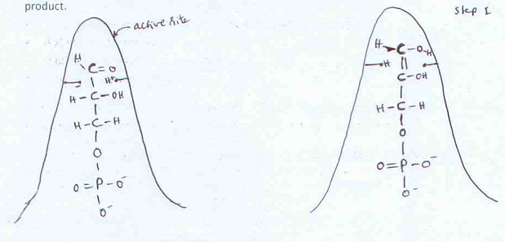
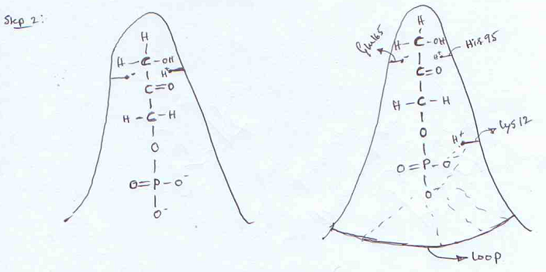
Step 1
Step 2
Glu 165’
His 95’
His95-95th amino acid is Histidine
Positively charged a.a (Indicated by BLACK arrow)
Appropriately present at the position to give
H+ ion to the 1st carbon of G3P
(His95 gives H⁺ to 1st carbon)
Glu165-Glutamic acid present at 165th position
Negatively charged (Indicated by RED arrow)
Appropriately present to take H+ from 2nd Carbon of G3P (Glu165 takes H⁺ from 2nd carbon)
Resulting molecule is cis-enediol Highly unstable
H⁺ from 2nd carbon is taken by His95 to again become +vely charged (His95 takes H⁺ from 2nd carbon)
H+ ion given by the glutamic acid to the 1st carbon atom of the molecule
(Glu165 gives H⁺ to 1st carbon)
Resulting molecule is DHAP
To stabilize the phosphate group (which is negatively charged), Lysine (positively charged) is present at the 12th amino
acid

